Slide 1
EECS 448 (Fall 2016): Project One: Calendar
By “Team One”:
Logan Ayer
Matthew Bauer
James Muoghalu
Luke Weaver

Slide 2
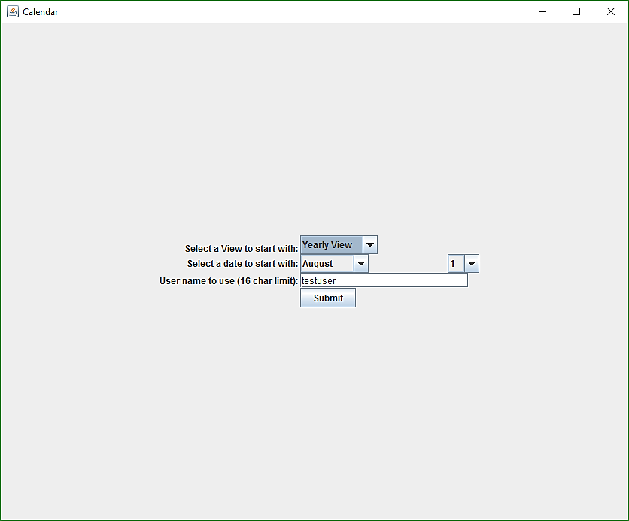
Overview
Platform
Java Swing application and a MySQL database
Functionality
The start menu accepts view selection, current month, and current day from the user.
The selected view opens in a new frame, and the start menu closes.
A “Back” button is present within each view, and it will close said view and return the user to the Start Menu.

Slide 3
Division of Labor
Logan
Day View database management
Matt
Week View; Month View; Day View base code; user interactivity
James
Year View; Presentation
Luke
Start Menu GUI; alternating between frames

Slide 4
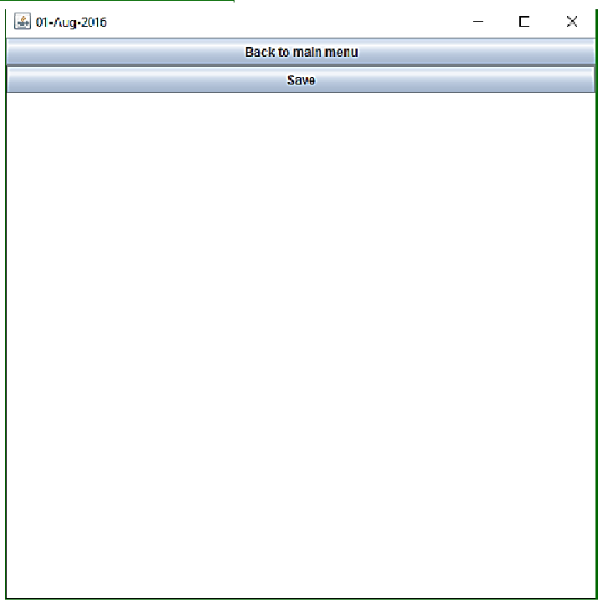
Day View
Users can change the contents of the text field at their leisure.
“Back to main menu” button will close the day view and reopen the start menu.
“Save” button will make a database entry or will alter an existing entry.

Slide 5
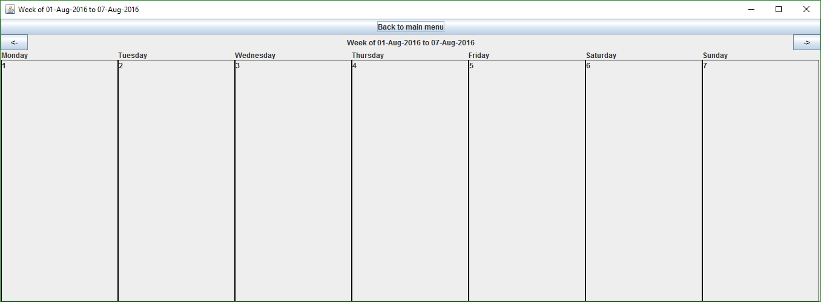
Week View
displays the Sunday-Saturday dates surrounding the user’s current selected date
buttons for accessing the next and previous weeks in the calendar
selectable Day boxes that will open the Day View for the clicked box

Slide 6
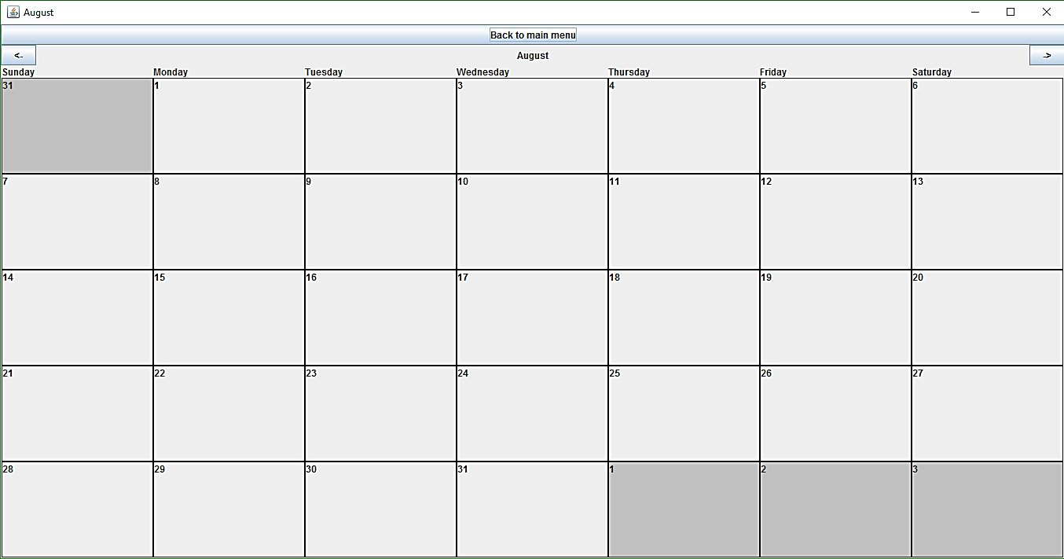
Month View
buttons for returning to the main menu and for accessing then next and previous calendar months
selectable Day boxes that will open the Day View for the clicked box

Slide 7
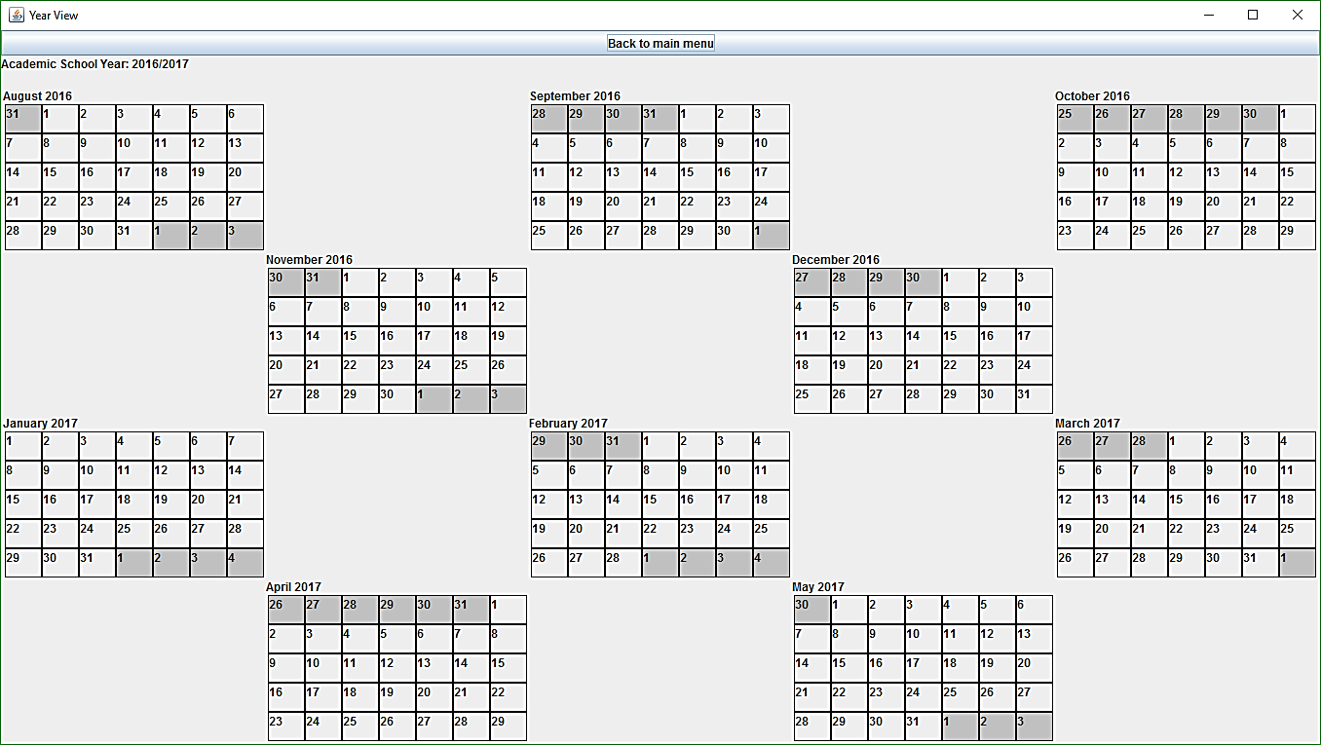
Year View
utilizes the Month View to display all dates in the August-May calendar
selectable Day boxes that will open the Day View for the clicked box

Slide 8
Some Sources Used
Oracle.com Java Swing tutorials
MySQL.com database references and documentation
a few YouTube tutorials
multiple Java libraries such as “Calendar,” “Gregorian Calendar” and various Swing libraries
(more comprehensive list available on project repository and within source files)

Slide 9
Desired Features That Are Not Present
some database interaction that would prevent the user from having to re-input the current date when the start menu is closed and reopened
having the Day View display information about important dates in the academic calendar
a way to close the Week, Month, or Year Views when the user clicks on one of the dates within said View
various aesthetic improvements to the display with regards to the size of the panels, background designs, Day View input fields, etc.

Slide 10
Retrospective
Challenges
There were some problems in accessing the database on Windows vs. Linux.
The way that we divided the work left some of our tasks unable to be completed until other group members were finished with their parts.
Improvement 1: More Communication
In some instances, we were not specifically telling each other how much progress we were making in our individual work. Doing so would have saved us some time wasted writing code that turned out to be unnecessary.
Improvement 2: More Planning Ahead
It would have been helpful to carefully read through the project requirements as a full group and make a detailed list of our plans to cover the requirements.

